Slide 1
Reservoir EngineeringII
University of Basrah
Collage of Engineering / Petroleum Engineering Department
4th year
Fall Semester 2017
By: Ahmed Al Alwan
WELCOME
اهلا وسهلا

Slide 2
Lecture rules
Quiet zone
Silent iphones and electronic devices
Raise your hand and feel free to ask questions (no hisitation)
Early showing up
Voting democracy (not all the time)
Group work
FT 10 Minuttes

Slide 3
Train your mind to think

Slide 4
Course materials and text books
Ahmed, Tarek 1964
Reservoir Engineering Handbook/4th eddition
B.C. Craft and M.F. Hawkings
Applied Petroleum Reservoir Engineering / 2nd Eddition

Slide 5
Course Outlines
INTRODUCTION TO PRIMARY RECOVERY MECHANISMS
THE MATERIAL BALANCE EQUATION
WATER INFLUX
GAS CONDENSATE RESERVOIRS

Slide 6
Lecture outlines
PRIMARY RECOVERY MECHANISMS
• Rock and liquid expansion drive
• Depletion drive
• Gas-cap drive
• Water drive
• Gravity drainage drive
• Combination drive
THE MATERIAL BALANCE EQUATION

Slide 7
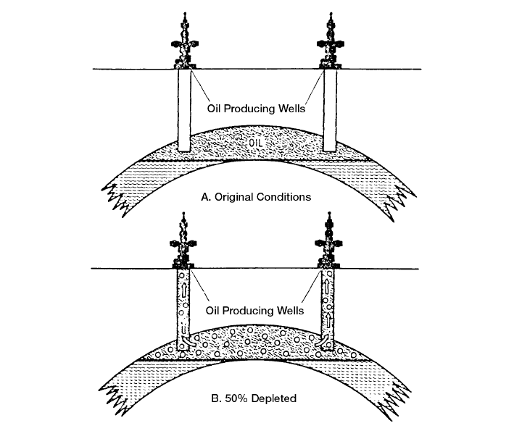
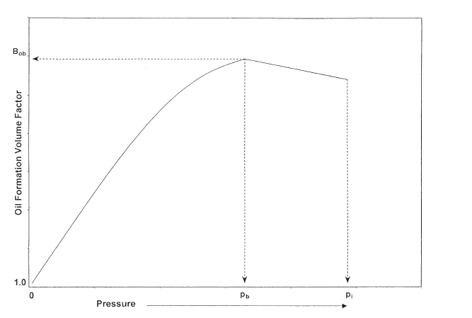
PRIMARY RECOVERY MECHANISMS
1- Rock and liquid expansion drive
Pressure higher than its bubble-point pressure, the reservoir is called an undersaturated-oil
reservoir.
1- Decrease in fluid pressure
2- Reduction in porosity and pore volume
3- Constant GOR
2- The Depletion-Drive Mechanism
• Solution gas drive
• Dissolved gas drive
• Internal gas drive

Slide 8
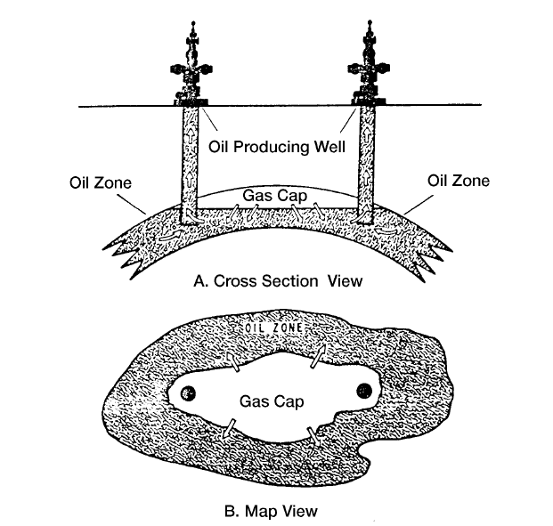
3- Gas-Cap Drive
• Expansion of the gas-cap gas
• Expansion of the solution gas as it is liberated

Slide 9
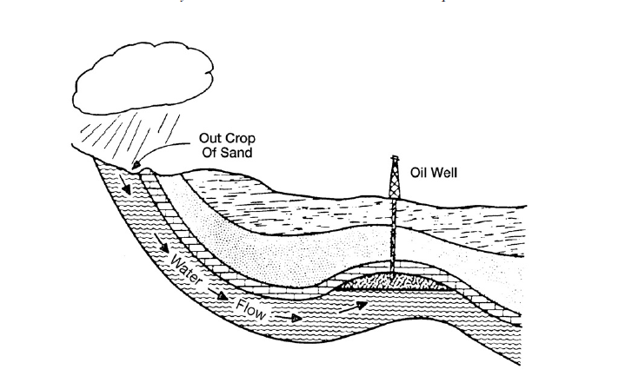
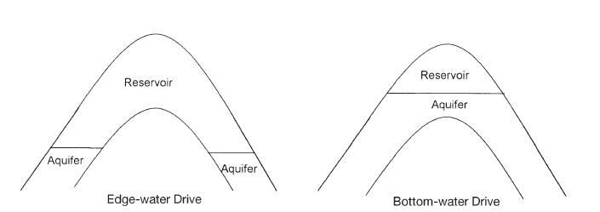
4- The Water-Drive Mechanism

Slide 10
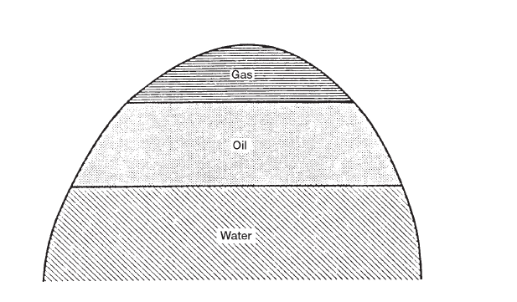
5- The Gravity-Drainage-Drive Mechanism

Slide 11
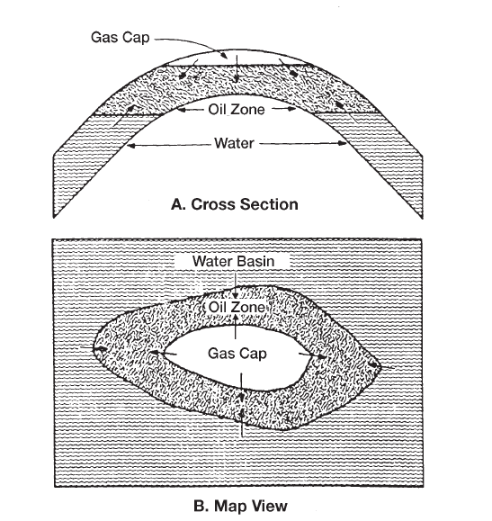
6- The Combination-Drive Mechanism

Slide 12
THE MATERIAL BALANCE EQUATION
• Estimate initial hydrocarbon volumes in place
• Predict future reservoir performance
• Predict ultimate hydrocarbon recovery under various types of primary driving mechanisms
Initial volume = volume remaining + volume removed

Slide 13
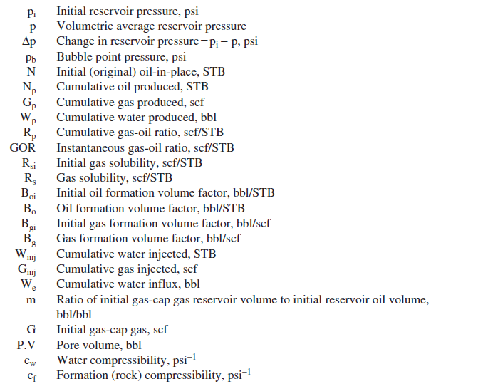
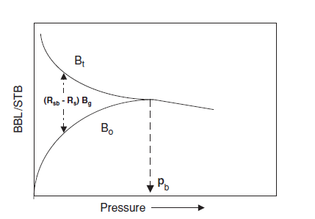
THE MATERIAL BALANCE EQUATION

Slide 14
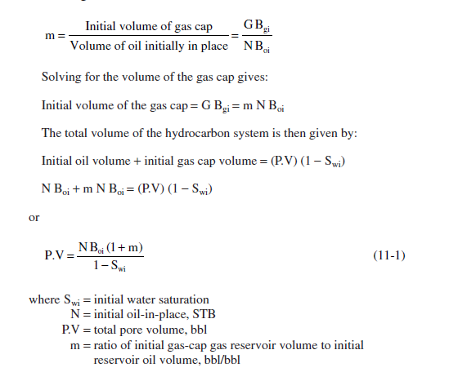
THE MATERIAL BALANCE EQUATION

Slide 15
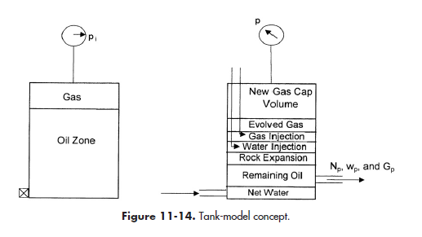
THE MATERIAL BALANCE EQUATION

Slide 16
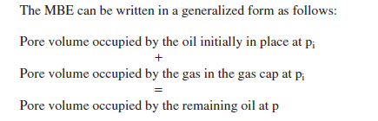
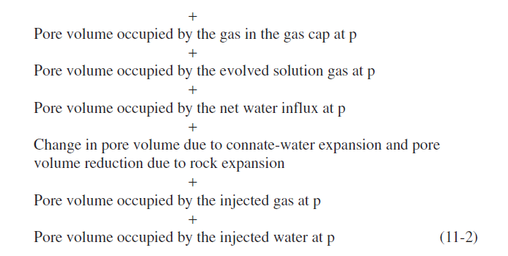
THE MATERIAL BALANCE EQUATION

Slide 17
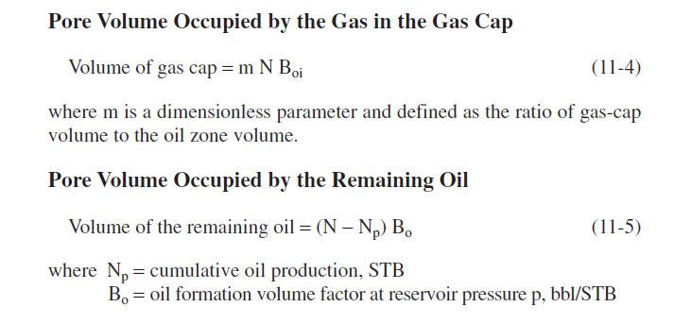

Slide 18
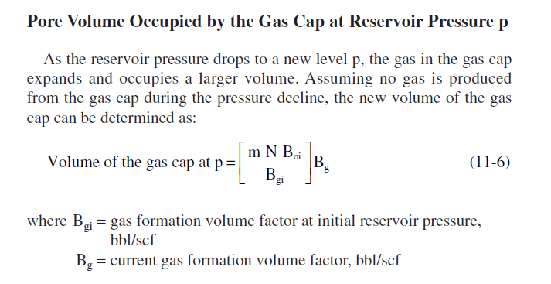

Slide 19
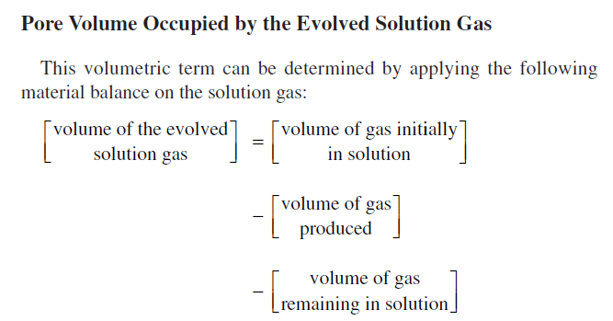
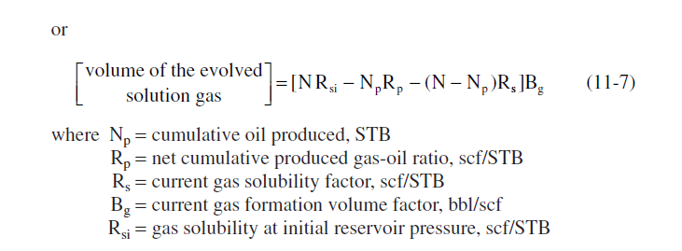

Slide 20
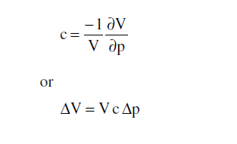
Change in Pore Volume Due to Initial Water and
Rock Expansion

Slide 21
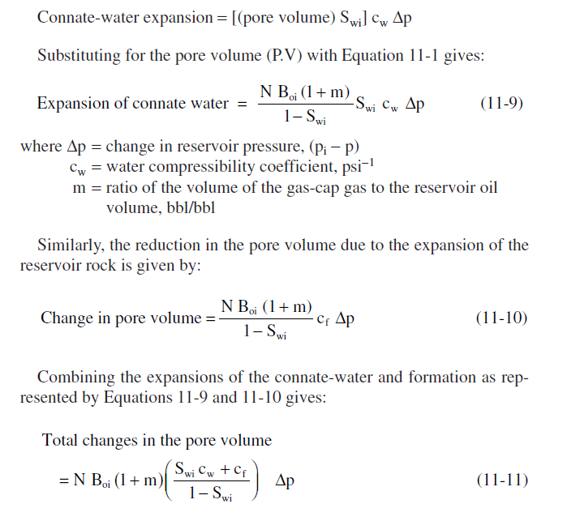

Slide 22
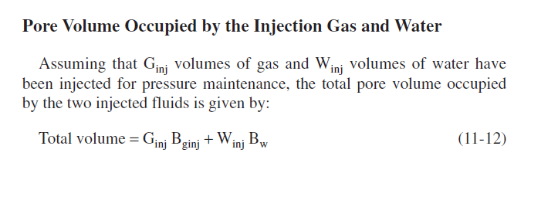
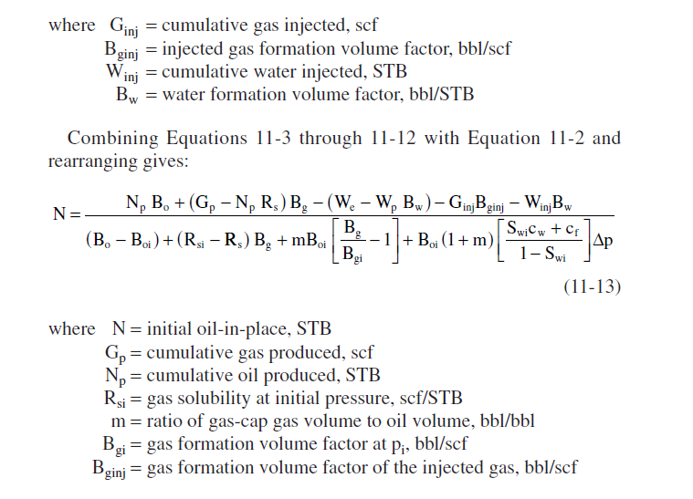

Slide 23
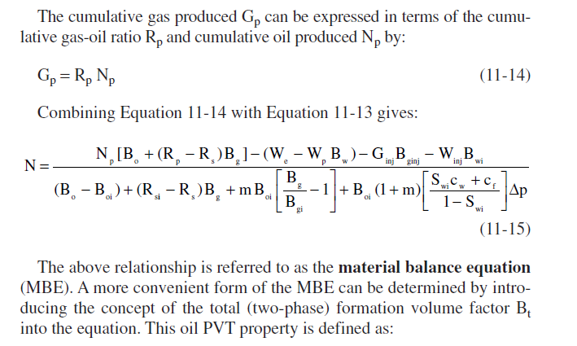

Slide 24
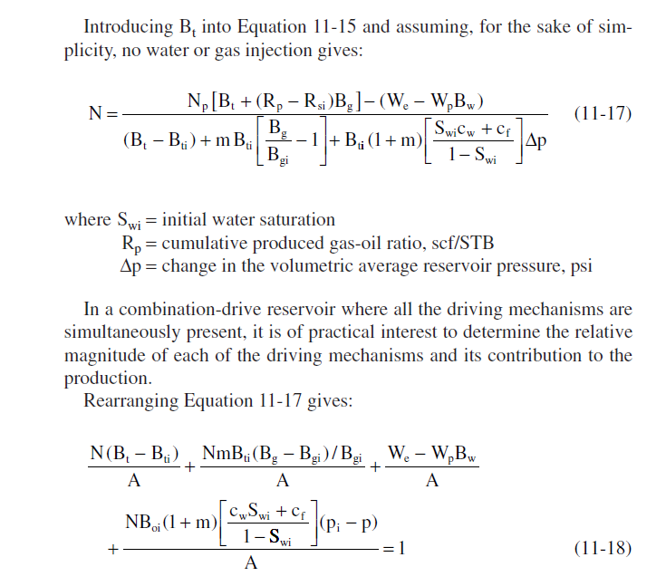

Slide 25
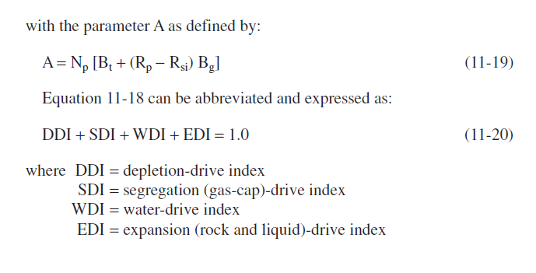

Slide 26
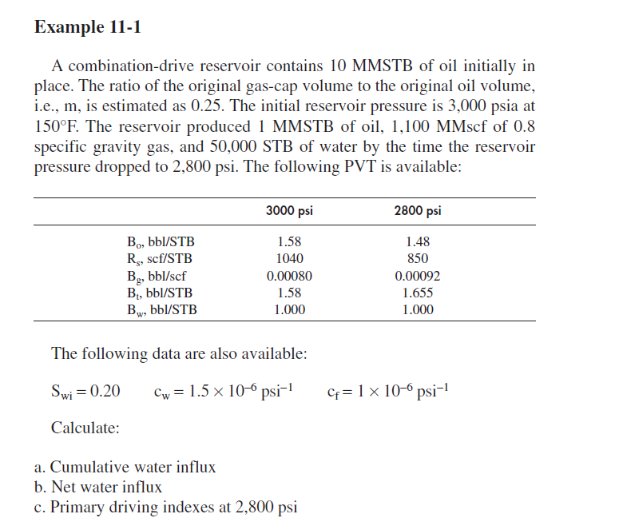

Slide 27
See you next time
HAVE A NICE TIME

